Slide 1
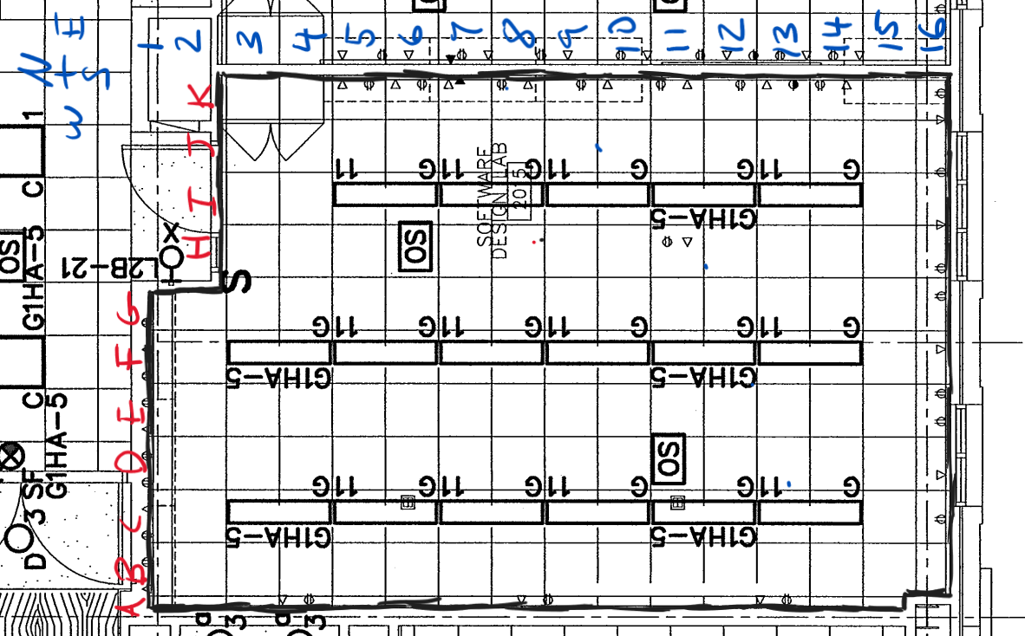

Slide 2
Zone 1

Slide 3
Zone 2

Slide 4
Zone 3

Slide 5
Zone 1
Zone 2

Slide 6
Zone 1
Zone 3

Slide 7
Zone 2
Zone 3

Slide 8
Zone 1
Zone 2
Zone 3

